Slide 1
Fingerprint Sensor Interfacing With Raspberry pi
Batch No: 180402
Team Members
1. K .Naveen [18BCE7323]
2. CH .Rutwik Reddy [18BCN7039]
3. G .Vamsi Krishna [18BCN7071]
4. N .Bharath Chandra [18BEC7077]
5. D .Dinesh [18BCE7247]
6. Sk .Imran [18MIS7190]
Guided by
Dr.Ravi Sankar Barpanda
Dept. of CSE

Slide 2
Agenda
Problem Definition
Circuit Diagram
Overall Flow Diagram
Module Implementation
Target Achievements in reviews.
TimeLine Chart
References

Slide 3
1. Problem Definition
This project is aims at developing Raspberry Pi based Fingerprint recognition to provide a better security and allow lethal accessibility to the society.
Being direct the use of this that it doesn’t allow the illegal accessibility to data or any other item that can be secured using fingerprint like lockers etc.

Slide 4
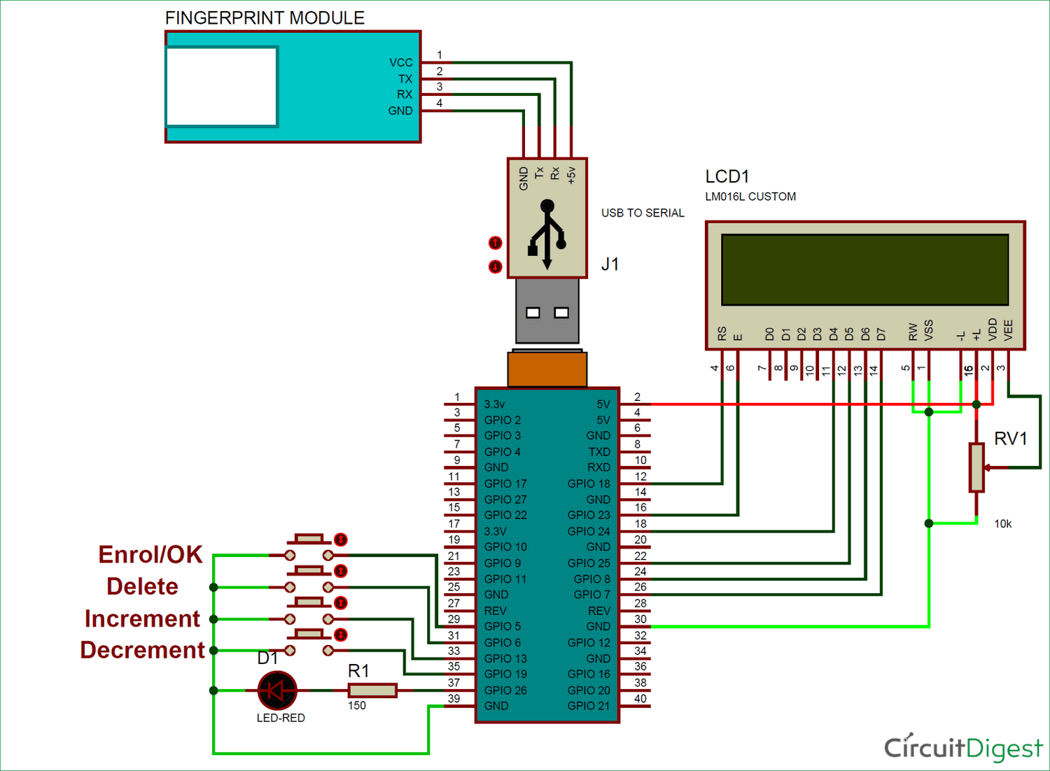
2. Circuit Diagram

Slide 5
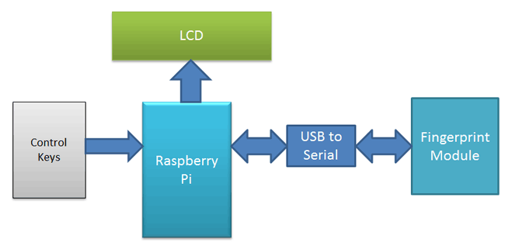
3. Overall Flow Diagram

Slide 6
4. Module Implementation
Fingerprint Sensor- Used to recognise or capture fingerprint that is to be used for identification.
USB to serial- This cable is used to connect Raspberry Pi.
LCD Display- This is used to display the Output.

Slide 7
5. Target Achievement
Upto Review 1 – Requirement Identification , Designing the System
Upto Review 2 - Module Implementation
Fingerprint sensor interfacing – Completed
Testing – Going to be tested
Upto Review 3- Further improvement.

Slide 8
5.Timeline Chart
Delivery
Testing
Coding – Raspberry Pi IDE
Integrating all modules
Hardware Analysis
Collection of Information
Modules | Dec 3rd and 4 th week | First 3 weeks of jan |  | Last week of jan and first week of Feb | First 3 weeks of Feb |  | First week of March | 3rd week of March

Slide 9
6.References
1.https://circuitdigest.com/microcontroller-projects/raspberry-pi-fingerprint-sensor-interfacing
2.https://tutorials-raspberrypi.com/how-to-use-raspberry-pi-fingerprint-sensor-authentication/
3. https://www.circuito.io/app?components=9443,11792,200000,341099

